Slide 1
Research Lab-1
Adaptive Streaming
Prepared By:
Dhrupa Patel (015265887)
Sai Kiran Madupu (015505243)

Slide 2
Problem Statement
We have to develop an algorithm that manages changes in bandwidth in real-time scenarios.
Focus on conditions other than failure detection like variable bandwidth, packet failures, spotty connections, etc.
In this research work we aim to develop an algorithm in which packet size of upcoming data adapts to changing bandwidth in real-time.
We have performed experiments with different input data sizes and bandwidth values to identify different network parameters in each case.

Slide 3
Choice of IO operation
Sending packet(s) of different packet size
based on current throughput value through gRPC channel
Client
Server
Client File System
Server File System

Slide 4
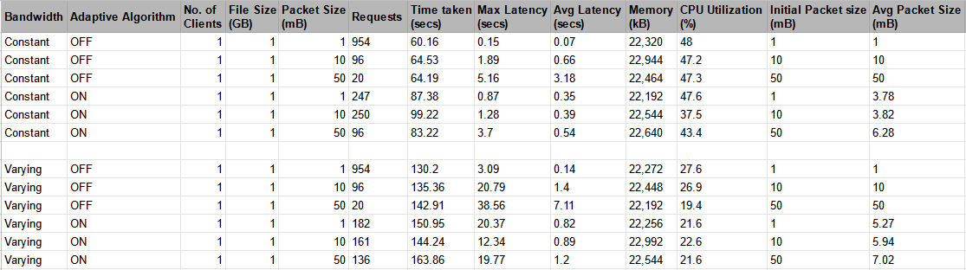
Effects of Packet Size on network parameters
Notes:
Constant Bandwidth: 50Mbps
Variable bandwidth: varying b/w pattern is as follows:
0-30 secs: max bandwidth (400 Mbps)
30-60 secs: 50 Mbps with 5% packet drop
60-90 secs: 150 Mbps with 2% packet drop
90-xx secs: max bandwidth (400 Mbps)
note that here the speed is in mega bits and we are considering megabytes.. so divide these speeds by 8

Slide 5
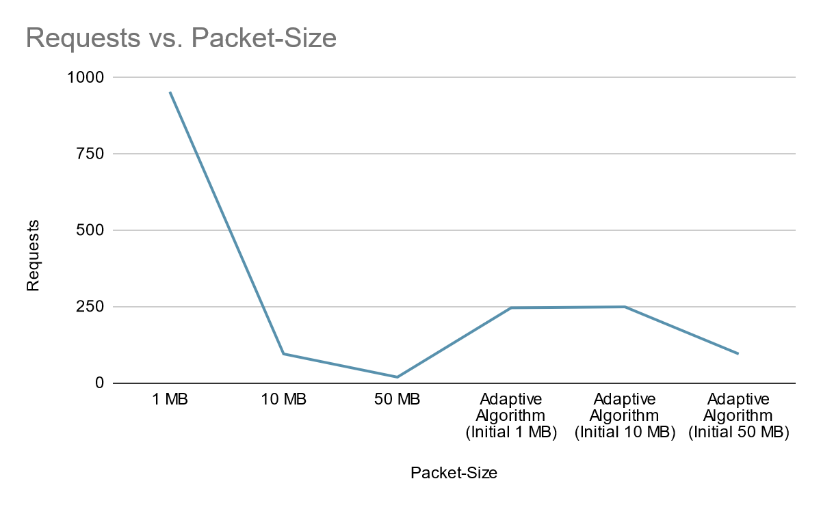
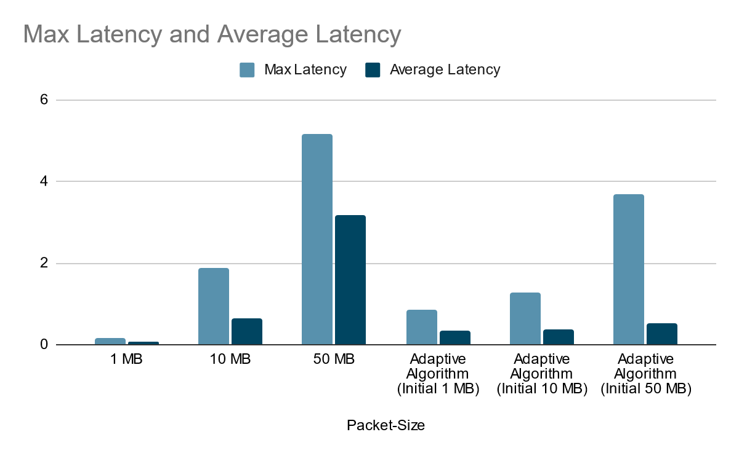
Experiment Results (Constant Bandwidth)

Slide 6
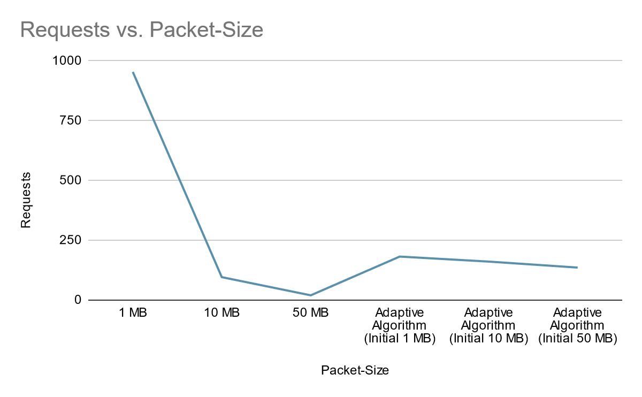
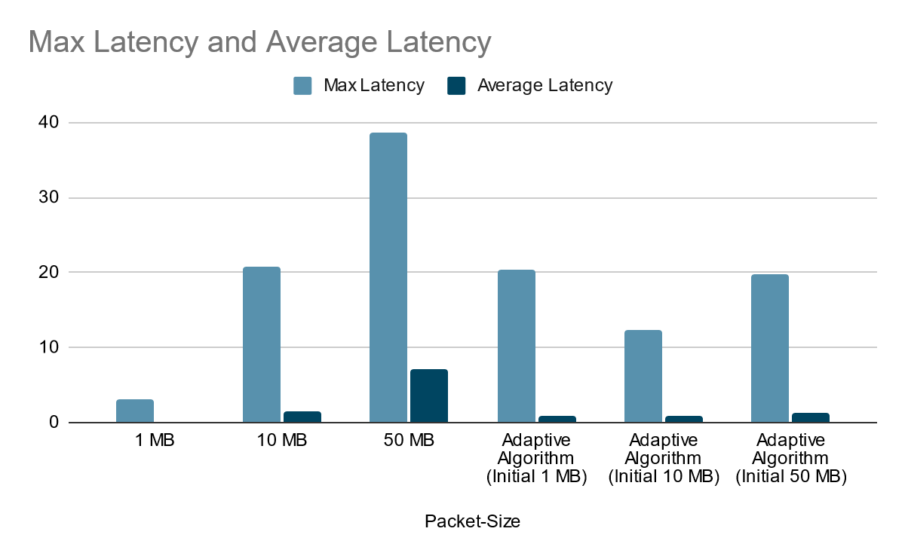
Experiment Results (Varying Bandwidth)

Slide 7
Experiment with two Clients and one server
Adaptive Algorithm | No. of Clients | File Size (GB) | Packet Size (mB) | Requests | Time taken (secs) | Max Latency (secs) | Avg Latency (secs) | Memory (kB) | CPU Utilization (%)
OFF | 2 | 1 (Client-1) | 10 | 96 | 171.54 | 16.21 | 1.77 | 23380 | 7.1
 |  | 1 (Client-2) | 10 | 96 | 241.17 | 22.02 | 2.5 | 22544 | 4.1
ON | 2 | 1 (Client-1) | 10 | 348 | 197.02 | 7.97 | 0.56 | 23268 | 7
 |  | 1 (Client-2) | 10 | 333 | 241.38 | 27.16 | 0.72 | 22656 | 3.5

Slide 8
Conclusion
Making a channel adaptive to changes in bandwidth in real-time to reduce overhead on network and possibly reduce the number of packet loss (for UDP Connections).
Also, bandwidth will be utilised at it’s best, if packet size has a linear relationship with bandwidth of the channel.
Notes:
For example, with TCP, if you had a small window size you would have more overhead for acknowledgements. If you had a large window size, you suffer the issue with failure re-sends.
Less packet size->less computational time
Large packet size minimize the wasted bandwidth of the header
small packet size is better since delay is smaller (for packetization) -e.g., voice.Plus no wastage of space when small amounts of data are transmitted (e.g.,in short messages/email, chat, etc.). disadvantage: packet header overhead.

Slide 9
References
https://psutil.readthedocs.io/en/latest/
https://www.tutorialspoint.com/grpc/grpc_unary.htm
https://grpc.io/docs/what-is-grpc/core-concepts/
https://www.geeksforgeeks.org/md5-hash-python/

Slide 10
Thank You!

